Slide 1

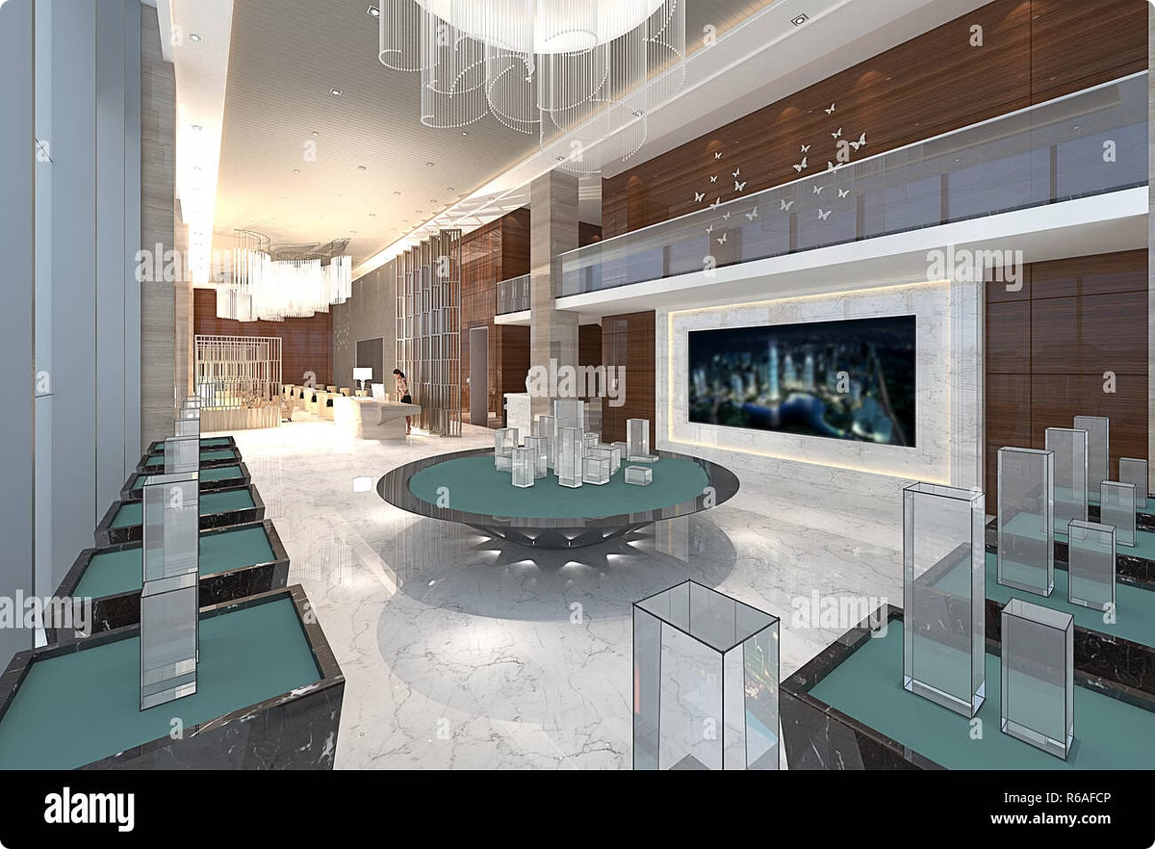
AtliQ Hospitality Analysis

Slide 2
Problem Statement:
Atliq Grands, a hospitality company with a 20-year history, owns multiple five-star hotels across India. Despite their established presence, Atliq Grands has faced challenges in recent years. Aggressive strategies from competitors and ineffective management decisions have resulted in declining market share and revenue within the luxury/business hotel segment. To address this situation, sAtliq Grands' managing director has decided to implement a "Business and Data Intelligence" approach as a strategic move to regain their market position and revenue.

Slide 3
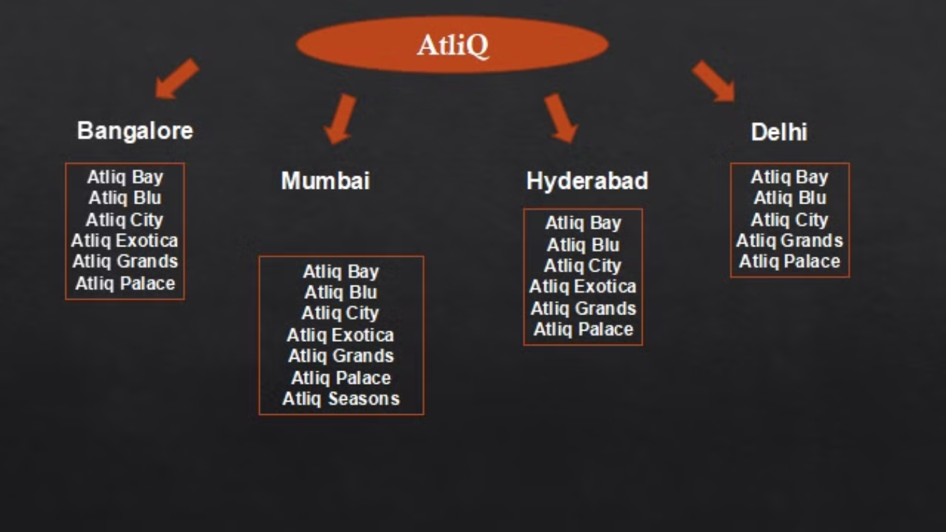
AtliQ Grands

Slide 4
Dataset Details:
We are provided 3 moths booking details data of all the atliq hotels.
Dataset contains 5 excel files.
Dim_date
Dim_hotels
Dim_rooms
Fact_aggregated_
bookings Fact_bookings

Slide 5
Expected Outcomes:
Regain their market share in business hotels category.
Understand the revenue trend by month/week/day.
Find where business is lagging and take important decisions to solve them.

Slide 6
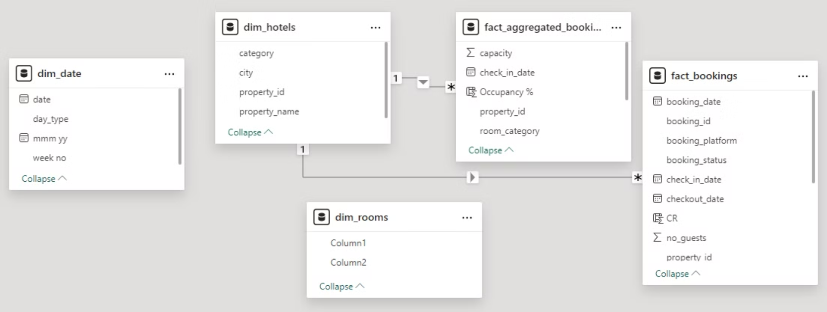
Data Model:

Slide 7
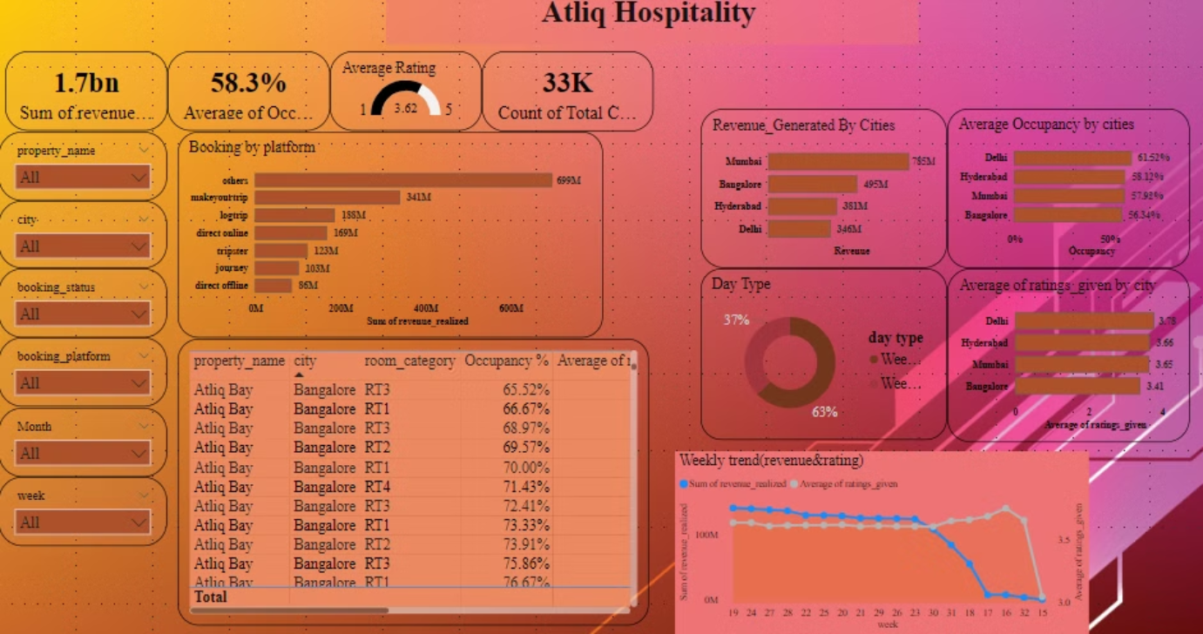
Report review:

Slide 8

THANK YOU

